Slide 1
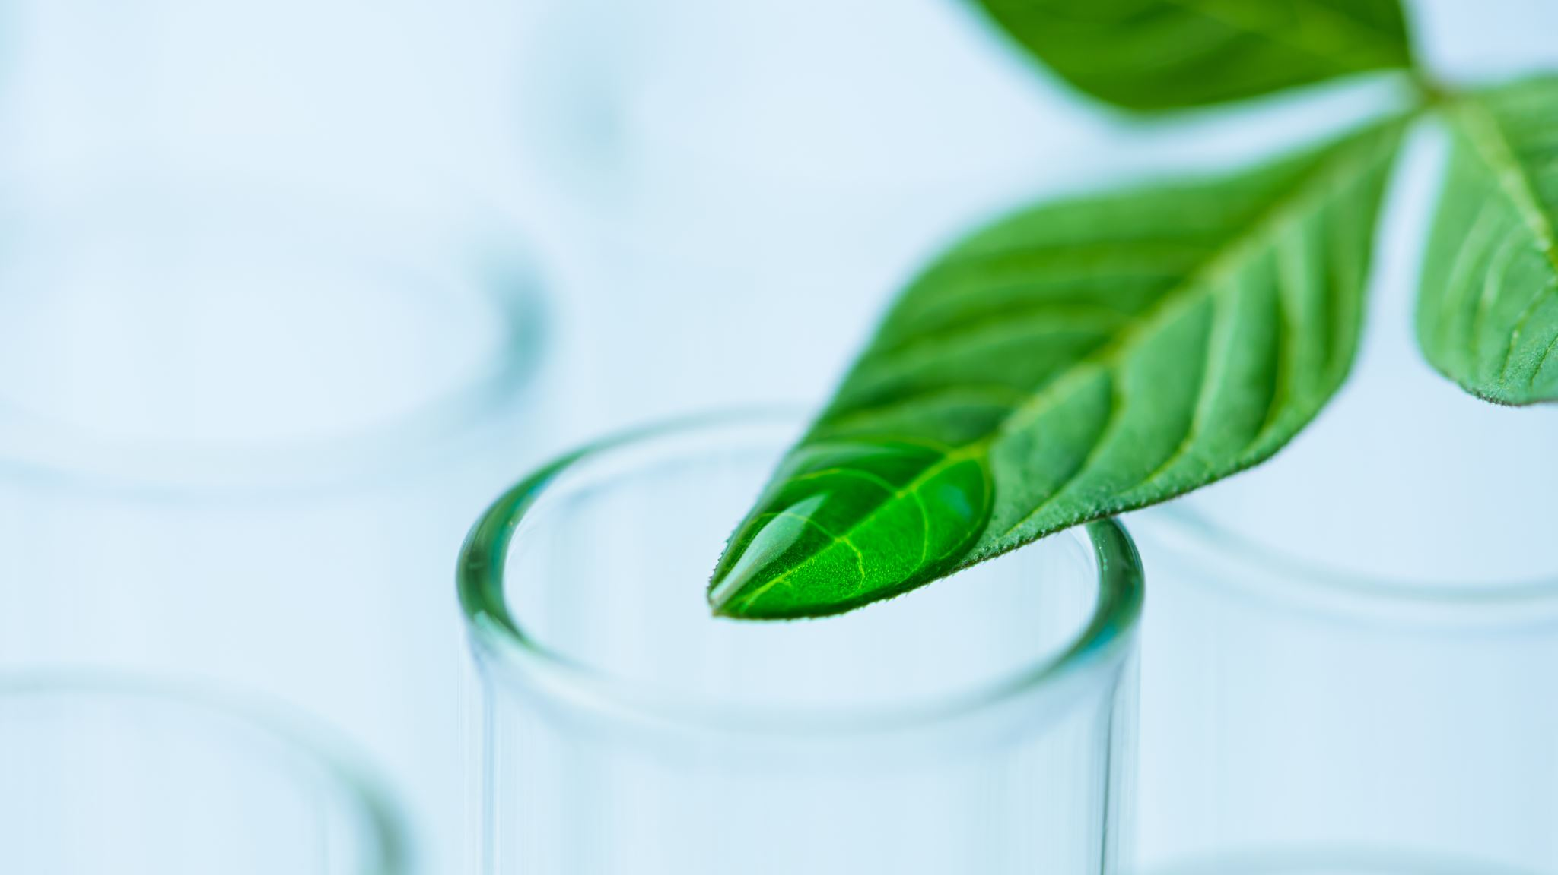
Deep Learning Powered Plant Disease Detection
By
Sowmith Kola
Neha Vunnam
Mourya Sashank Sure

Slide 2

Introduction
The agricultural industry, comprising more than 570 million farms globally, has historically relied on manual inspections. As an illustration, in a study conducted in 2010, it required a team of five specialists two weeks to inspect a 50-acre farm.
In India, where approximately 60% of its 1.3 billion inhabitants are engaged in agriculture, manual inspections can be time-consuming, leading to delays in essential crop management tasks.
Recent advancements in machine learning and image recognition have significantly enhanced accuracy rates. For example, a study conducted in 2020 demonstrated a 95% accuracy rate in the identification of grape leaf diseases through the use of AI.

Slide 3
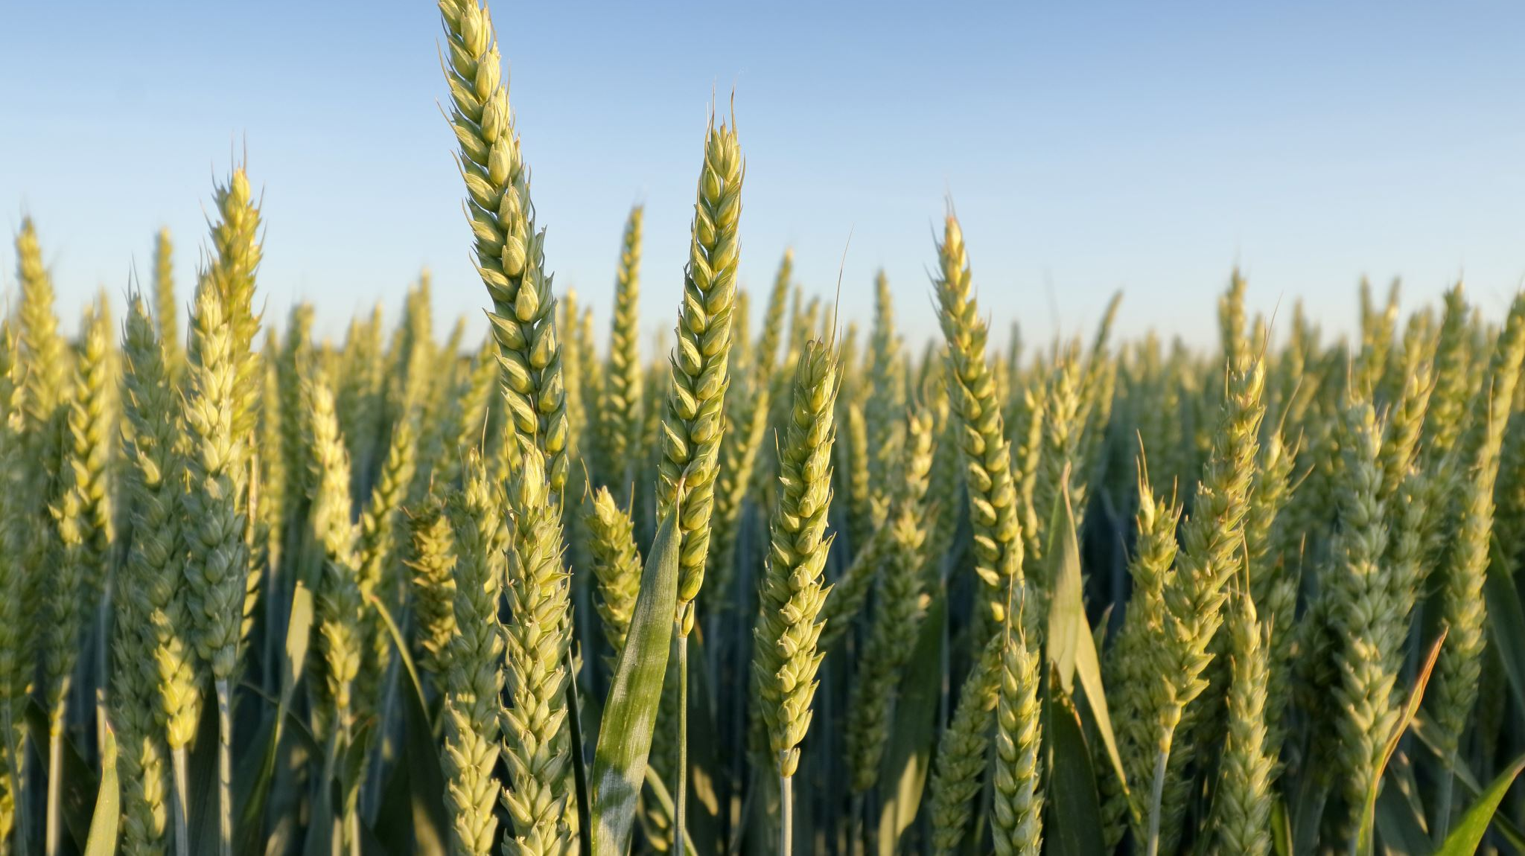
Dataset
Dataset Size: Approximately 87,000 RGB images are included, offering a diverse range of healthy and diseased crop leaves.
Image Categories: The dataset encompasses 38 different classes representing various plant species and diseases.
Kaggle Dataset

Slide 4
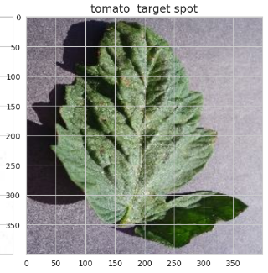
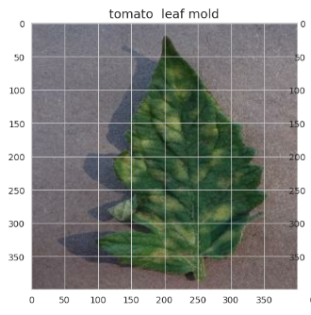
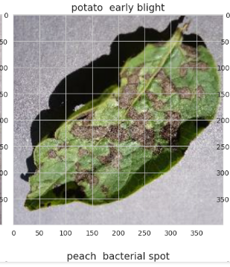
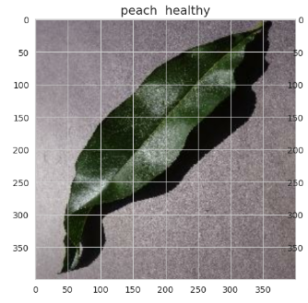
Data Augmentation

Slide 5
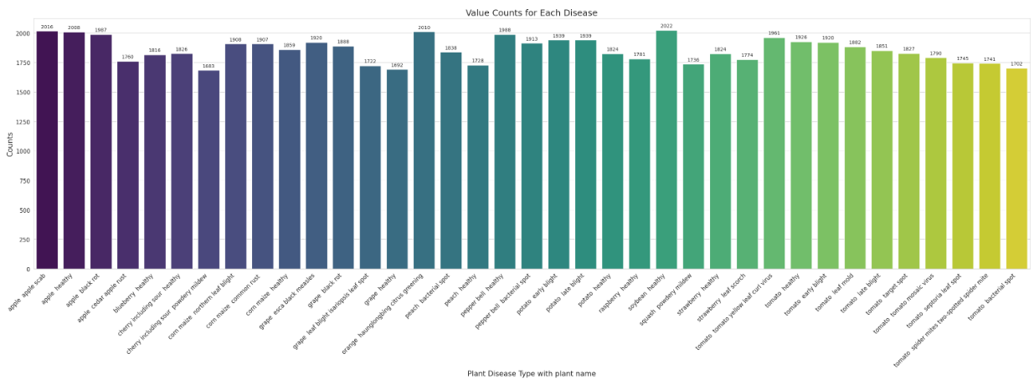
EDA

Slide 6
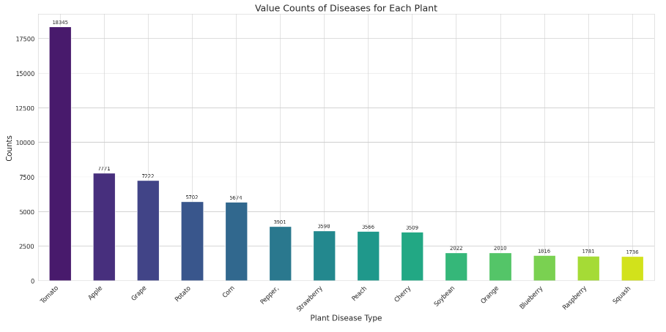

Slide 7
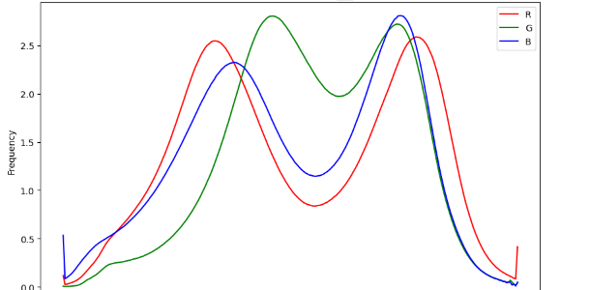
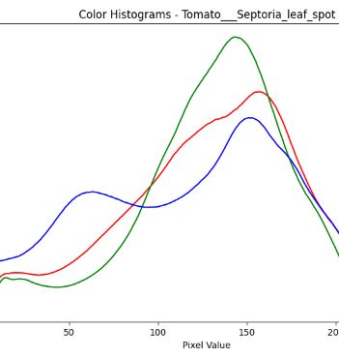
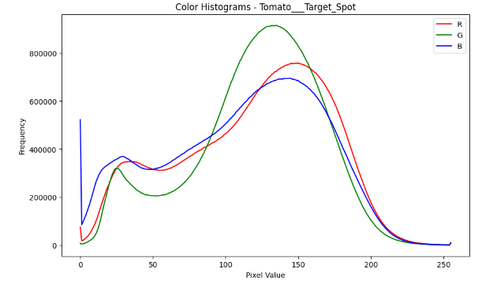

Slide 8

These additional EDA steps provide deeper insights into image characteristics, color distributions, and preprocessing effects, which can be valuable for both understanding your dataset and optimizing your image preprocessing pipeline and model architecture.

Slide 9
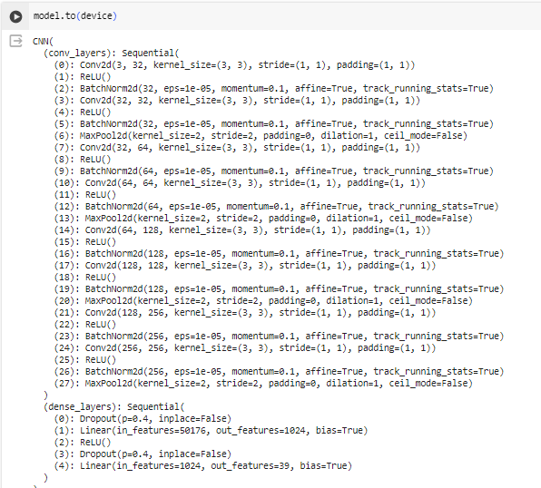
Model

Slide 10
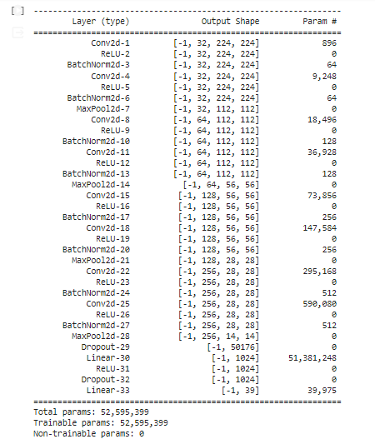

Slide 11
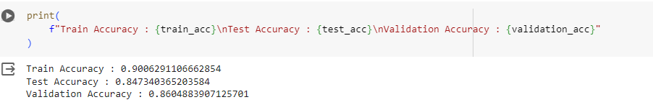
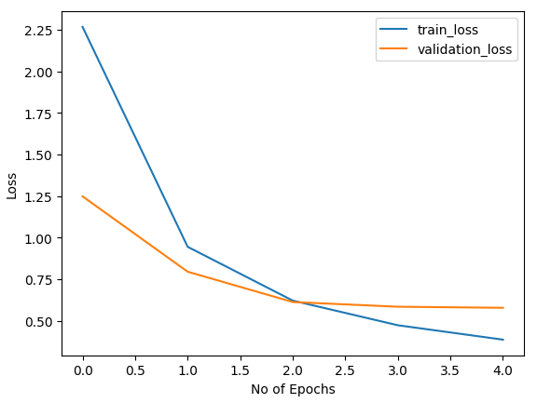
Evaluation

Slide 12

Next Steps
Need to try different approaches and models, like adding more neural network layers and hyper parameter tuning.
Changing activation layers and optimizers to get the good accuracy and to try the model efficiently.

Slide 13

Thank You

